Slide 1
The Guardian Production

Slide 2
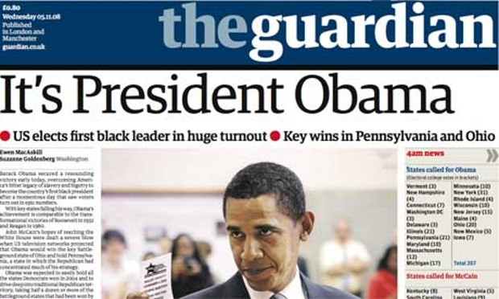
The Guardian invested heavily in their offices at King Place; which opened in 2008.
The Guardian Print Centre is in Stratford.
Kings Place had 24 editing desks, and 7 recording studios for podcasts.
They were the first to produce webcasts, podcasts and blogs.
Overall, several hours of podcasts were produced per week.
The Guardian was the first British newspaper to produce web first stories.
The digital investment in order to create newspaper, was estimated at £20 million.
Wemedia and UGC (user generated content) in the age of Web2 means that the audience are now prosumers (a person who consumes and produces media).

Slide 3
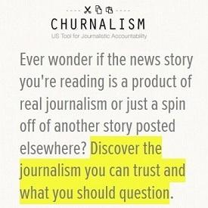
The quality of news produced by Guardian journalists had been examined in Nick Davies ‘Flat Earth News’.
60% of the quality print stories consisted wholly or mainly of wire copy and/or PR material.
The Guardian had the lowest percentage, but it was still more than 50%.
Newspapers are looking to limit costs of production.
Guardian tried becoming user friendly by turning the format into the Berliner format in 2005.
Most newspaper cutting costs through redundancies – Guardian cut 250 workers and 100 of these were editors.
Guardian recently reduced costs by redcing inserts in newspapers
Guardians main priority is their website which is reinforced by their web-first policy.
They are an extremely popular digital news provider attracting over 9 million unique daily browsers in 2016.
Alan Rusbridger – ex editor of The Guardian – says that the future for newspapers is online but he also says that this movement is expensive.
Alan Rusbridger

Slide 4
Guardian are looking to cut costs further by going completely online.
The Guardian Media Group recently sold their regional newspapers to Trinity Mirror for £44.8m.
Company reports say The Guardian Media Group are operating at a loss of £69m this year – July 2015 to July 2016.
Circulation figures are down to 156,756 a day compared to the 1.66m of The Sun and the 1.51m of the Daily Mail.
Their website is designed to have a high level of multimedia content and to be interactive.
On loading the site there are options for either the main digital site or the mobile version.
It also has a breaking news section which is constantly updated.
The Guardian website has an archive of previous issues allowing past news stories to be read.

